Slide 1
Earnings and Discrimination
© 2015 Cengage Learning. All Rights Reserved. May not be copied, scanned, or duplicated, in whole or in part, except for use as permitted in a license distributed with a certain product or service or otherwise on a password-protected website for classroom use.

Slide 2
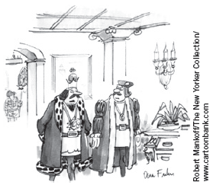
Determinants of Equilibrium Wages
Compensating differentials
  Difference in wages that arises to offset the nonmonetary characteristics of different jobs
  Higher supply of labor for “good” jobs
    Lower equilibrium wage
  Lower supply of labor for “bad” jobs
    Higher equilibrium wage
“On the one hand, I know I could make more money if I left public service for the private sector, but, on the other hand, I couldn’t chop off heads.”
© 2015 Cengage Learning. All Rights Reserved. May not be copied, scanned, or duplicated, in whole or in part, except for use as permitted in a license distributed with a certain product or service or otherwise on a password-protected website for classroom use.

Slide 3
Human Capital
Human capital
  Accumulation of investments in people
    Education
    On-the-job training
  Higher productivity
  Workers with more human capital earn more
© 2015 Cengage Learning. All Rights Reserved. May not be copied, scanned, or duplicated, in whole or in part, except for use as permitted in a license distributed with a certain product or service or otherwise on a password-protected website for classroom use.

Slide 4
Human Capital
Firms – demanders of labor
  Willing to pay more for highly educated workers
    Higher marginal products
Workers - suppliers of labor
  Willing to pay the cost of becoming educated
    Only if there is a reward for doing so
© 2015 Cengage Learning. All Rights Reserved. May not be copied, scanned, or duplicated, in whole or in part, except for use as permitted in a license distributed with a certain product or service or otherwise on a password-protected website for classroom use.

Slide 5
Human Capital
Wage differentials
  Highly educated workers earn higher wages
  Less educated workers earn lower wages
  Compensating differential
    Cost of becoming educated
© 2015 Cengage Learning. All Rights Reserved. May not be copied, scanned, or duplicated, in whole or in part, except for use as permitted in a license distributed with a certain product or service or otherwise on a password-protected website for classroom use.

Slide 6
The increasing value of skills
Earnings gap
  Between skilled and unskilled workers increased over the past two decades
    Man with a college degree
      1975, 42% higher earnings than without a college degree
      2011, 75% higher earnings
    Woman with a college degree
      1975, 35% higher earnings than without a college degree
      2011, 81% higher earnings
© 2015 Cengage Learning. All Rights Reserved. May not be copied, scanned, or duplicated, in whole or in part, except for use as permitted in a license distributed with a certain product or service or otherwise on a password-protected website for classroom use.

Slide 7
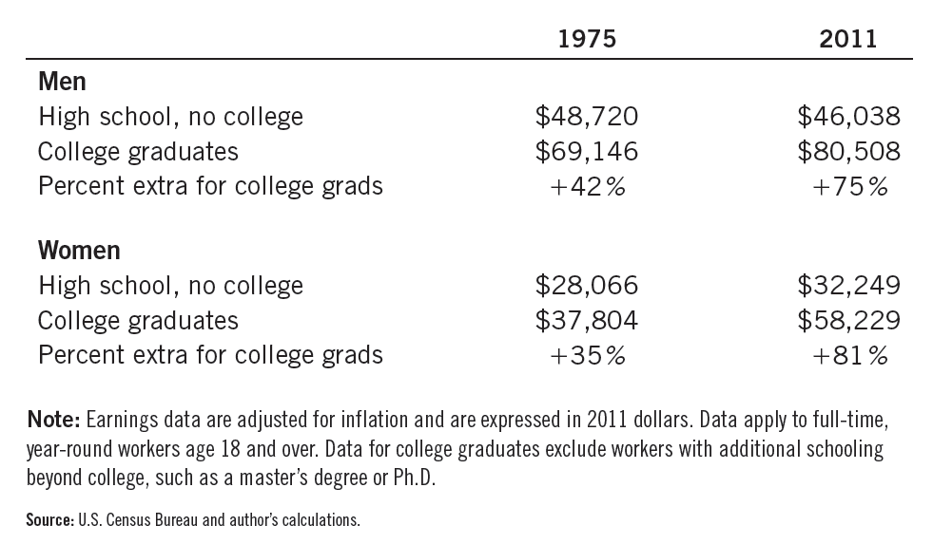
Table 1
Average Annual Earnings by Educational Attainment
College graduates have always earned more than workers without the benefit of college, but the salary gap has grown even larger over the past few decades.
© 2015 Cengage Learning. All Rights Reserved. May not be copied, scanned, or duplicated, in whole or in part, except for use as permitted in a license distributed with a certain product or service or otherwise on a password-protected website for classroom use.

Slide 8
The increasing value of skills
Widened earnings gap
  Increased demand for skilled labor relative to unskilled labor
    Higher wages for skilled labor
    Greater inequality
  Two possible causes:
    Increase in international trade
    Changes in technology
© 2015 Cengage Learning. All Rights Reserved. May not be copied, scanned, or duplicated, in whole or in part, except for use as permitted in a license distributed with a certain product or service or otherwise on a password-protected website for classroom use.

Slide 9
The increasing value of skills
Increase in international trade
  Domestic demand for skilled labor rises
  Domestic demand for unskilled labor falls
Changes in technology
  Raise the demand for skilled workers who can use the new machines
  Reduce the demand for the unskilled workers whose jobs are replaced by the computers
© 2015 Cengage Learning. All Rights Reserved. May not be copied, scanned, or duplicated, in whole or in part, except for use as permitted in a license distributed with a certain product or service or otherwise on a password-protected website for classroom use.

Slide 10
Ability, Effort, and Chance
Natural ability
  Workers with greater natural ability earn more
Effort
  People who work hard are more productive and earn more
Chance
  Can influence wage
© 2015 Cengage Learning. All Rights Reserved. May not be copied, scanned, or duplicated, in whole or in part, except for use as permitted in a license distributed with a certain product or service or otherwise on a password-protected website for classroom use.

Slide 11

The benefits of beauty
How prevalent are the economic benefits of beauty?
  Labor economists Daniel Hamermesh & Jeff Biddle
  More attractive people
    Earn 5% more than people of average looks
  People of average looks
    Earn 5 to 10% more than people considered less attractive than average
Good looks pay.
© 2015 Cengage Learning. All Rights Reserved. May not be copied, scanned, or duplicated, in whole or in part, except for use as permitted in a license distributed with a certain product or service or otherwise on a password-protected website for classroom use.

Slide 12
The benefits of beauty
What explains these differences in wages?
  Good looks- a type of innate ability
    Determines productivity and wages
    Attractive worker - more valuable to the firm
      Acting, sales, and waiting on tables
      Firm’s willingness to pay more to attractive workers
        Reflects its customers’ preferences
© 2015 Cengage Learning. All Rights Reserved. May not be copied, scanned, or duplicated, in whole or in part, except for use as permitted in a license distributed with a certain product or service or otherwise on a password-protected website for classroom use.

Slide 13
The benefits of beauty
What explains these differences in wages?
  Reported beauty - indirect measure of other abilities
    Dress, hairstyle, personal demeanor
      Attributes that a person can control
      Perhaps - more likely to be an intelligent person who succeeds at other tasks as well
  Beauty premium - type of discrimination
© 2015 Cengage Learning. All Rights Reserved. May not be copied, scanned, or duplicated, in whole or in part, except for use as permitted in a license distributed with a certain product or service or otherwise on a password-protected website for classroom use.

Slide 14
Signaling
Earn a college degree
  No real productivity benefit
  Signal high ability to prospective employers
    Easier for high-ability people to earn a college degree
© 2015 Cengage Learning. All Rights Reserved. May not be copied, scanned, or duplicated, in whole or in part, except for use as permitted in a license distributed with a certain product or service or otherwise on a password-protected website for classroom use.

Slide 15
Signaling
Human-capital theory
  Education – workers more productive
  Policy to increase education attainment
    Higher productivity and wages
Signaling theory
  Education – natural ability
  Policy to increase education attainment
    No increase in productivity
    No change in wages
© 2015 Cengage Learning. All Rights Reserved. May not be copied, scanned, or duplicated, in whole or in part, except for use as permitted in a license distributed with a certain product or service or otherwise on a password-protected website for classroom use.

Slide 16
The Superstar Phenomenon
Superstars in the field
  Great public appeal and astronomical incomes
Superstars arise in markets where
  Every customer in the market
    Wants the good supplied by the best producer
  The good is produced with a technology
    That makes it possible for the best producer to supply every customer at low cost
© 2015 Cengage Learning. All Rights Reserved. May not be copied, scanned, or duplicated, in whole or in part, except for use as permitted in a license distributed with a certain product or service or otherwise on a password-protected website for classroom use.

Slide 17
Above-Equilibrium Wages
Reasons for above-equilibrium wages
  Minimum-wage laws
  Market power of labor unions
  Theory of efficiency wages
Effects of above-equilibrium wages
  Surplus of labor
  Unemployment
© 2015 Cengage Learning. All Rights Reserved. May not be copied, scanned, or duplicated, in whole or in part, except for use as permitted in a license distributed with a certain product or service or otherwise on a password-protected website for classroom use.

Slide 18
Above-Equilibrium Wages
Union
  Worker association - bargains with employers over wages & working conditions
Strike
  Organized withdrawal of labor from a firm by a union
Efficiency wages
  Above-equilibrium wages paid by firms to increase worker productivity
© 2015 Cengage Learning. All Rights Reserved. May not be copied, scanned, or duplicated, in whole or in part, except for use as permitted in a license distributed with a certain product or service or otherwise on a password-protected website for classroom use.

Slide 19
Economics of Discrimination
Discrimination
  Offering of different opportunities to similar individuals who differ only by
    Race
    Ethnic group
    Sex
    Age
    Other personal characteristics
© 2015 Cengage Learning. All Rights Reserved. May not be copied, scanned, or duplicated, in whole or in part, except for use as permitted in a license distributed with a certain product or service or otherwise on a password-protected website for classroom use.

Slide 20
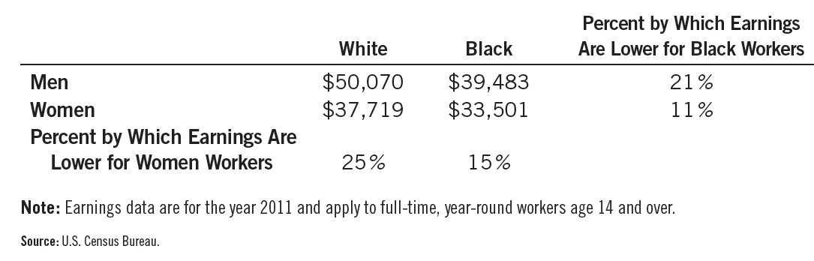
Table 2
Median Annual Earnings by Race and Sex
© 2015 Cengage Learning. All Rights Reserved. May not be copied, scanned, or duplicated, in whole or in part, except for use as permitted in a license distributed with a certain product or service or otherwise on a password-protected website for classroom use.

Slide 21
Economics of Discrimination
Different groups of workers earn substantially different wages
  Discrimination?
  Human capital
    Quality and quantity of education
    Job experience
  Kinds of work able & willing to do
  Compensating differentials
    Working conditions
© 2015 Cengage Learning. All Rights Reserved. May not be copied, scanned, or duplicated, in whole or in part, except for use as permitted in a license distributed with a certain product or service or otherwise on a password-protected website for classroom use.

Slide 22
Economics of Discrimination
Differences in educational attainment
  2011, men age 25 and older
    32% of the white population had a college degree
    18% of the black population
  2011, women age 25 and older
    31% of the white population had a college degree
    21% of the black population
© 2015 Cengage Learning. All Rights Reserved. May not be copied, scanned, or duplicated, in whole or in part, except for use as permitted in a license distributed with a certain product or service or otherwise on a password-protected website for classroom use.

Slide 23
Economics of Discrimination
Quality of public schools
  As measured by: expenditure, class size, and so on
  Historically: public schools in predominantly black areas have been of lower quality than public schools in predominantly white areas
© 2015 Cengage Learning. All Rights Reserved. May not be copied, scanned, or duplicated, in whole or in part, except for use as permitted in a license distributed with a certain product or service or otherwise on a password-protected website for classroom use.

Slide 24
Economics of Discrimination
Human capital acquired in the form of job experience
  Women are more likely to interrupt their careers to raise children
  Population aged 25 to 34
    75% of women are in the labor force
    90% of men
© 2015 Cengage Learning. All Rights Reserved. May not be copied, scanned, or duplicated, in whole or in part, except for use as permitted in a license distributed with a certain product or service or otherwise on a password-protected website for classroom use.

Slide 25
Economics of Discrimination
Compensating differentials
  Men and women do not always choose the same type of work
  Women are more likely to be secretaries
  Men are more likely to be truck drivers
  Different working conditions
© 2015 Cengage Learning. All Rights Reserved. May not be copied, scanned, or duplicated, in whole or in part, except for use as permitted in a license distributed with a certain product or service or otherwise on a password-protected website for classroom use.

Slide 26
Is Emily more employable than Lakisha?
Economists Marianne Bertrand & Sendhil Mullainathan
  Answered more than 1,300 help-wanted ads run in Boston and Chicago newspapers
  Send in nearly 5,000 fake résumés - similar
    Half of the résumés had names that were common in the African American community
    The other half had names that were more common among the white population
© 2015 Cengage Learning. All Rights Reserved. May not be copied, scanned, or duplicated, in whole or in part, except for use as permitted in a license distributed with a certain product or service or otherwise on a password-protected website for classroom use.

Slide 27
Is Emily more employable than Lakisha?
Results
  Job applicants with white names
    Received about 50% more calls
  Discrimination occurred for all types of employers
  Conclusion
    “Racial discrimination is still a prominent feature of the labor market”
© 2015 Cengage Learning. All Rights Reserved. May not be copied, scanned, or duplicated, in whole or in part, except for use as permitted in a license distributed with a certain product or service or otherwise on a password-protected website for classroom use.

Slide 28
Discrimination by Employers
If one group in society receives a lower wage than another group
  Even after controlling for human capital and job characteristics
  Who is to blame for this differential?
    Employers - discriminatory wage differences?
Competitive market economies
  Natural antidote to employer discrimination: profit motive
© 2015 Cengage Learning. All Rights Reserved. May not be copied, scanned, or duplicated, in whole or in part, except for use as permitted in a license distributed with a certain product or service or otherwise on a password-protected website for classroom use.

Slide 29
Discrimination by Employers
Workers differentiated by hair color
  Blondes and brunettes
    Same skills, experience, and work ethic
    Discrimination: employers prefer not to hire blondes
  Demand for blondes – lower
    Blondes - earn a lower wage
© 2015 Cengage Learning. All Rights Reserved. May not be copied, scanned, or duplicated, in whole or in part, except for use as permitted in a license distributed with a certain product or service or otherwise on a password-protected website for classroom use.

Slide 30
Discrimination by Employers
Workers differentiated by hair color
  New firms - hire blonde workers
    Lower wages
    Lower production costs
    Higher profits
  “Brunette” firms
    Higher production costs
    Diminishing profits
    Losses
© 2015 Cengage Learning. All Rights Reserved. May not be copied, scanned, or duplicated, in whole or in part, except for use as permitted in a license distributed with a certain product or service or otherwise on a password-protected website for classroom use.

Slide 31
Discrimination by Employers
Workers differentiated by hair color
  “Brunette” firms to go out of business
  Eventually:
    Demand for blonde workers – rises
    Demand for brunette workers – falls
    Wage differential disappears
  Competitive markets
    Have a natural remedy for employer discrimination
© 2015 Cengage Learning. All Rights Reserved. May not be copied, scanned, or duplicated, in whole or in part, except for use as permitted in a license distributed with a certain product or service or otherwise on a password-protected website for classroom use.

Slide 32
Segregated streetcars and the profit motive
Early 20th century
  Streetcars in many southern cities were segregated by race
    White passengers sat in the front of the streetcars
    Black passengers sat in the back
© 2015 Cengage Learning. All Rights Reserved. May not be copied, scanned, or duplicated, in whole or in part, except for use as permitted in a license distributed with a certain product or service or otherwise on a password-protected website for classroom use.

Slide 33
Segregated streetcars and the profit motive
Why?
  Laws required such segregation
  Before these laws were passed, racial discrimination in seating was rare
  Common to segregate smokers and nonsmokers
© 2015 Cengage Learning. All Rights Reserved. May not be copied, scanned, or duplicated, in whole or in part, except for use as permitted in a license distributed with a certain product or service or otherwise on a password-protected website for classroom use.

Slide 34
Segregated streetcars and the profit motive
Firms that ran the streetcars
  Often opposed the laws requiring racial segregation
  Separate seating for different races
    Raised firms’ costs
    Reduced firms’ profit
© 2015 Cengage Learning. All Rights Reserved. May not be copied, scanned, or duplicated, in whole or in part, except for use as permitted in a license distributed with a certain product or service or otherwise on a password-protected website for classroom use.

Slide 35
Segregated streetcars and the profit motive
General lesson
  Business owners - more interested in making profit
    Than in discriminating against a particular group
  When firms engage in discriminatory practices
    Ultimate source of the discrimination often lies not with the firms themselves but elsewhere
© 2015 Cengage Learning. All Rights Reserved. May not be copied, scanned, or duplicated, in whole or in part, except for use as permitted in a license distributed with a certain product or service or otherwise on a password-protected website for classroom use.

Slide 36
Economics of Discrimination
Discrimination by customers and governments
  Limits to the profit motive corrective abilities
  Customer preferences (discriminatory)
    Willing to pay to maintain the discriminatory practice
  Government policies
    Mandate discriminatory practices
© 2015 Cengage Learning. All Rights Reserved. May not be copied, scanned, or duplicated, in whole or in part, except for use as permitted in a license distributed with a certain product or service or otherwise on a password-protected website for classroom use.

Slide 37
Discrimination in sports
Measuring discrimination is often difficult
  Correct for differences in the productivity
Professional sports team
  Can measure productivity
  Racial discrimination is common
    Much of the blame lies with customers
      Discriminatory wage gap can persist
      Even if team owners care only about profit
Market prices of old baseball cards
  Customer discrimination
© 2015 Cengage Learning. All Rights Reserved. May not be copied, scanned, or duplicated, in whole or in part, except for use as permitted in a license distributed with a certain product or service or otherwise on a password-protected website for classroom use.

